Slide 1
FPD Drinking Metrics
Project Status Reporting
Alexander Bretoi, Sara Iqbal, Kevin Ou, Jamia Russell
Northwestern University
MSDS 475: Project Management
Project Status Reporting
August 11th, 2024

Slide 2
Introduction
Introduction
“Today we will be providing a few updates on the metrics dashboard project. These will be related to project timeline, change requests, and data issues. We will review our current budget and available resources for best use the remainder of the project. Next, based on the mentioned updates and changes team members will be assigned roles to complete the necessary tasks. To wrap up, we will discuss next steps and have time allotted for questions you all may have.”
“The goal of today’s meeting is to discuss updates and decide the best path forward to project completion.”

Slide 3
Agenda
9:00 am Welcome
Meeting Objective/Agenda Breakdown
9:05 Project Schedule Update
Discuss Project Status
Discuss Schedule Updates
Discuss Programming Delay
Vacation Time
9:25 Project Issues/Change Requests
Data Quality Issues
Resource Limitations
Software Changes/Freeze
Additional Dashboard Data
9:40 Budget and Resources
Update Budget and Resource Use
Impact of Change Request
9:45 Roles and Responsibilities
New Assignments/Tasks Based on Project Updates
Change Request Assignments
9:50 Action Items/What’s Next
Schedule Upcoming Meetings/Milestones
Review of Immediate Tasks
9:55 Questions and Answers (Q&A)
Open for Questions
Final Remarks

Slide 4
Inform, Discuss, Decide
INFORM | Programming Delay Unsure of Return FPD Holiday Break Last week of year Vacation Time Policy End of Year Deadline IT Software Freeze December 1
DISCUSS | Marketing Personnel Change Request (Additional Dashboard Data) Data Quality Issues
DECIDE | Programming Delay Resolution Assignments for Change Request (Additional Data) Add Consultants to Construct and Test Software
RED: Critical/ Needs Immediate Attention
YELLOW: Needs Attention
GREEN: On Target Schedule

Slide 5
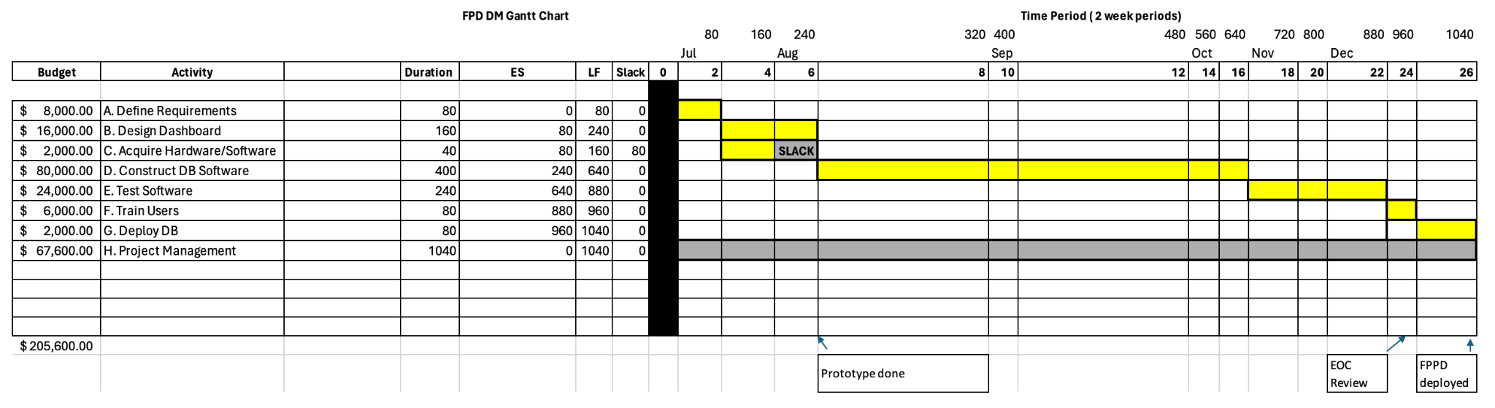
Original Gantt Chart

Slide 6
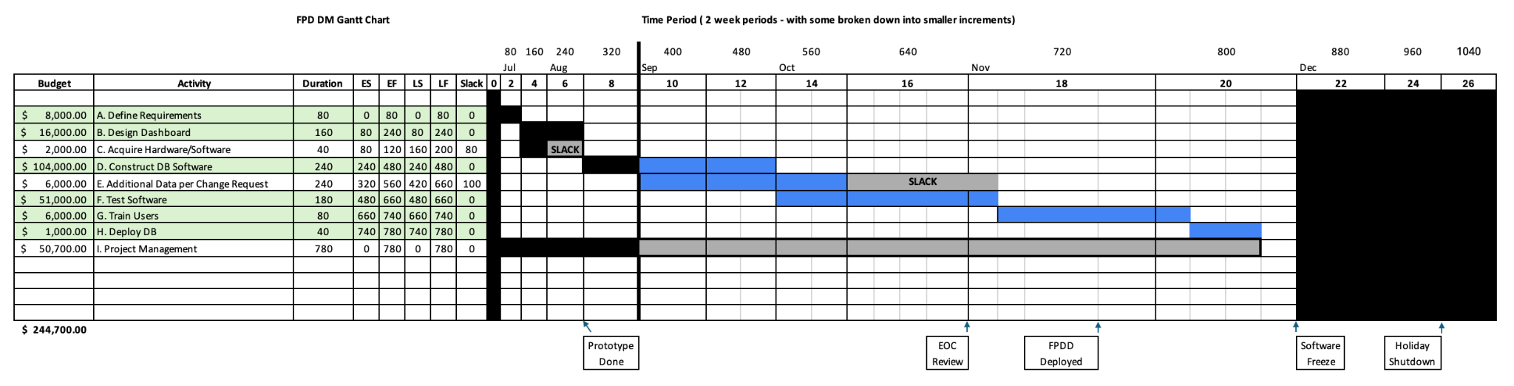
Expedited Gantt Chart
Note: Condensed timeline with 2 consultants brought in at $75/hour to assist with D. Construct DB Software, and F. Test Software.
Notes:
Summary of Changes:
1. The duration of the E. Additional Data per Change Request activity has been added as 30 days post-estimate, and can be completed alongside the D. Construct DB Software and F. Test Software in tandem with additional Slack time available to adjust as necessary through testing.
2. The critical path remains the same: A, B, D, F, G, and H.
3. The maximum late finish (LF) is now 780 hours (around 97.5 working days), which is still within the required maximum of 800 hours (100 working days) to complete prior to freeze on December 1st.
Initial Schedule Condensed:
To condense the initial schedule and complete the project within the required 800 hours (100 working days), the following steps were taken:
1. Two additional consultants were added to D. Construct DB Software, increasing the budget by $24,000 and reducing the duration from 400 hours to 240 hours (at $75/hour for an additional 160 hours, considering 80 hours of work was already complete without consultants).
2. Two additional consultants were added to F. Test Software, increasing the budget by $27,000 and reducing the duration from 240 days to 180 days (at $75/hour for 180 hours).
3. Durations for activities like the F. Test Software and H. Deploy DB were also condensed through additional consulting resources, and time constraining efforts. .
4. The total project budget increased by $39,100 to accommodate the additional consultants.
5. By utilizing additional consultants, reducing activity durations, and optimizing the schedule, the project could be condensed to finish within the required 800 hours (100 working days) while still maintaining the critical path and accommodating the Change Request.

Slide 7
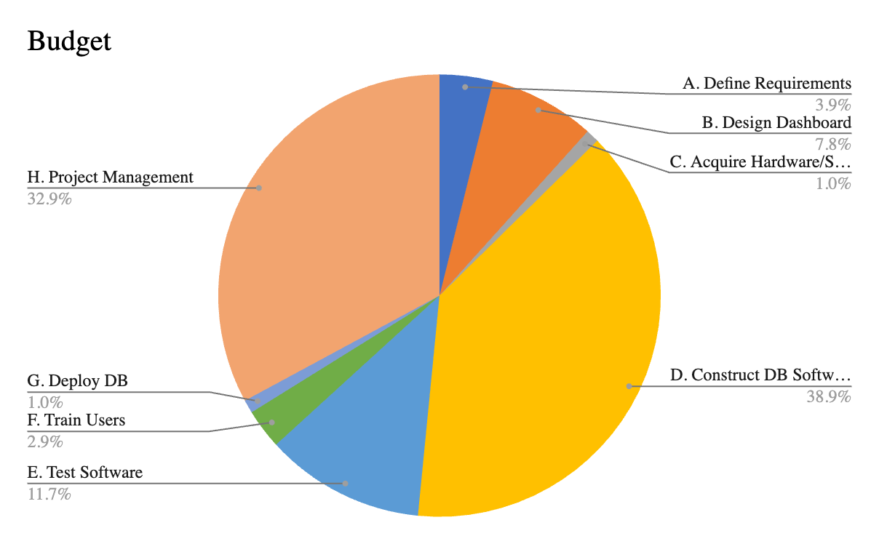
Estimated Budget and Financials
Activity | Budget
A. Define Requirements | $ 8,000.00
B. Design Dashboard | $ 16,000.00
C. Acquire Hardware/Software | $ 2,000.00
D. Construct DB Software | $ 80,000.00
E. Test Software | $ 24,000.00
F. Train Users | $ 6,000.00
G. Deploy DB | $ 2,000.00
H. Project Management | $ 67,600.00
Emergency (Add'l. Expenses, Consulting, etc.) | $44,400.00

Slide 8
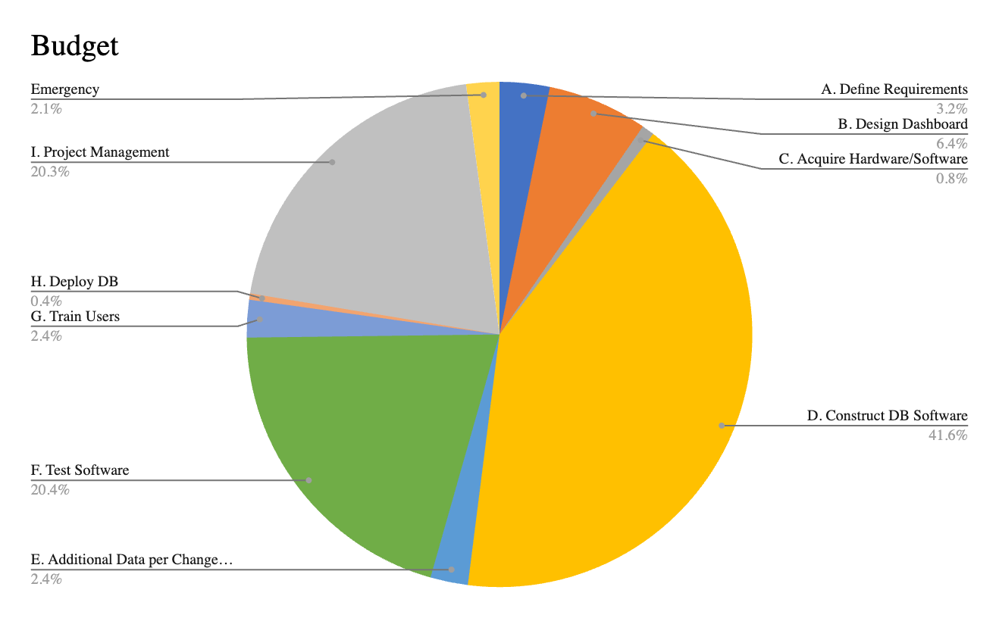
Updated Budget (As of 8/31)
Activity | Budget
A. Define Requirements | $ 8,000.00
B. Design Dashboard | $ 16,000.00
C. Acquire Hardware/Software | $ 2,000.00
D. Construct DB Software | $ 104,000.00
E. Additional Data per Change Request | $ 6,000.00
F. Test Software | $ 51,000.00
G. Train Users | $ 6,000.00
H. Deploy DB | $ 1,000.00
I. Project Management | $ 50,700.00
Emergency (Add'l. Expenses, Consulting, etc.) | $ 5,300.00
Note: Condensed timeline with 2 consultants brought in at $75/hour to assist with
D. Construct DB Software, and F. Test Software.

Slide 9
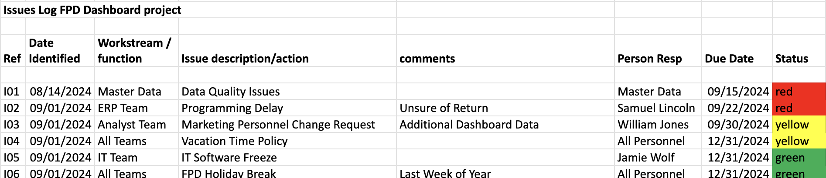
Issue Log

Slide 10
Project Governance Structure
EOC RESPONSIBILITIES
Meet 1x monthly with Project Manager
Shape and advise overall direction, allocate resources
Make key decisions, resolve escalated issues, and risk management
EOC
Barbara Coffee
(CEO)
Paul Reporting (CFO/Project Sponsor)
Frank Modruson
(CIO)
Angela Daniels
(VP of Logistics)
Vivica Frederickson (Investor)
Project Management Office (PMO)
PMO RESPONSIBILITIES
Lead execution, enforcing guiding principles
Link between EOC and functional teams
Manage budget, synergy governance and provide reporting to EOC
Jamia Russell, Project Manager
FUNCTIONAL LEADS
IT Development
ERP
Finance
Facilities
Analyst Team
HR & Payroll
FUNCTIONAL TEAM RESPONSIBILITIES
Meet weekly with Project Manager
Identify activities that need to occur and the timeline for each
Perform/delegate day-to-day planning & roadmap tasks
Proactively escalate issues/risks to Project Manager
Provide business/technical expertise
Jamie Wolf - IT Manager
Samuel Lincoln,
ERP Analyst
Fin. Support
Facilities/Building Operations Team
William Jones
Taraji Samson
Michael David
Jamie Levitt
Robert Schafer
Roger Scott
HR Team
IT Team
Nia Short, ERP Analyst
Marketing
Customer Service
Legal - Restructuring
Communications
Master Data
Steve James
(VP - Marketing)
Customer Service Team
Legal Team
Comms Team
Data Transformation/
Engineering Team

Slide 11
Project Communications Plan
What Information | Target Audience | When? | Method of Communication | Provider
Weekly Team Meeting | Project Team Members | Weekly | E-mail; In-Person Meetings | Project Manager
Team Status Reports | Project Manager | Weekly | E-mail | Project Team Members
Project Status Reports & Agendas | Executive Oversight Committee (EOC) Project Team Members | Weekly | E-mail (Hard Copy As Requested) | Project Manager
Monthly Review Meeting | Executive Oversight Committee (EOC) Project Team Members | Monthly | E-mail; In-Person Meetings | Project Manager
Milestones & Deliverables Reports | Executive Oversight Committee (EOC) | Monthly | E-mail (Hard Copy As Requested) | Project Manager
Emergency Escalations | Project Manager | As Needed | Meeting (Zoom); E-mail; Slack | Project Team Members
Change Requests | Executive Oversight Committee (EOC) | As Needed | E-mail (Hard Copy As Requested) | Project Manager

Slide 12
Change Request Implementation
E. Additional Data per Change Request can be completed within the timeline.
Slack time available for adjustments during testing.
Compliance with Constraints
Project aligns with software freeze, vacation policy, and plant closing.
Meeting WalMart’s Schedule
Project schedule fits within 800 hours (100 working days).
Critical path remains A. Define Requirements, B. Design Dashboard, D. Construct DB Software, F. Test Software, G. Train Users, H. Deploy DB
Summary of Schedule Condensation
Added consultants to D. Construct DB Software and F. Test Software.
Increased budget by $39,100 to reduce durations.
Maintained critical path and accommodated change request.
Summary Discussion

Slide 13
Q&A

